Slide 1




Accountable Discourse
for Teachers of Gifted Students
Dr. Ofer Keren Tali Lacks-Zur Shiri Lev-Ary
Funded by the European Union. Views and opinions expressed are however those of the author(s) only and do not necessarily reflect those of the European Union or the National Agency. Neither the European Union nor National Agency can be held responsible for them.

Slide 2


Accountable Discourse – Rational:
Allowing each student to participate in a fertile theoretical discourse.
A Community of Discourse respects democracy.
Peer meetings of different views and opinions.
Expressing one's voice with respect to the other.

Slide 3
Accountable Discourse - 3 rules:
Commitment to the community.
Commitment to standards thinking.
Commitment to knowledge.
3

Slide 4
Commitment to the community
Atmosphere, respectful discourse, room for various voices.
Listening, responding ➔ contributes to the discourse.
Asking, objecting, explaining ➔ contributes to the discourse.
4

Slide 5
Commitment to standards of thinking
Standards of thinking, unlike associations or intuitions, demand precision.
Ideas are fully and logically presented and explained.
Argumentative activity: the participants "speak" their thinking while self-controlled.

Slide 6
Commitment to standards of thinking
Standards of thinking, unlike associations or intuitions, demand precision.
Ideas are fully and logically presented and explained.
Argumentative activity: the participants "speak" their thinking while self-controlled.

Slide 7
Commitment to knowledge
Trusted sources, facts, laws, studies, expert— opinions, etc.
Provide evidence—based claims and explanations, counter arguments, and drowned conclusions accordingly.
7

Slide 8
The Ethical Code for Peer Assessment
We are establishing our process on transparency honesty and professional openness.
We investigate our profession in order to learn and develop and not to judge or criticize.
We assume it’s only a part of a wider connection.

Slide 9


GATE project 1st Learning, Teaching and Training Activity (LTTA)
October 17-21, 2022
Kaunas Lithuania
Seminar by
Dr. Yehuda Hamovitz

Slide 10
GATE dissemination workshop
Workshop’s program
Day 1 – The gifted arena.
Day 2 - The image of the gifted children's teacher.
Day 3 –Learning strategies and assembling a Leeson.
Day 4 - Participants give monitored and feedbacked lessons.
Day 5 - Teaching techniques and learning strategies.

Slide 11

The gifted arena

Slide 12
The gifted arena
Purposes and targets of the workshop.
Definitions of giftness.
Measuring, testing and identifying the gifted child.
The characteristics, behaviors and sociability of the gifted child along his maturation period.
What can be expected from the identified gifted child in terms of academic abilities, learning pace, learning difficulties?

Slide 13

The gifted arena
Purposes and targets of the workshop

Slide 14
Main objective of the overall project:
Build a national program that will trace, select, teach and educate the gifted children living in the country.
Giving children from all layers of society a fair and equal chance to bring forward their qualities and abilities.
Develop a perception of personal excellence, moral and social responsibility aside involvement and personal commitment to the environment and to the other.

Slide 15
Main components of the program:
Promote nurturing programs that answer cognitive, emotional, social and moral needs and aspects of the gifted throughout the years.
Trace and select gifted and excellent pupils and referring them to the adequate program suiting them and their needs.
Develop research and assessment tools to evaluate the program and its success while developing cooperation with other developed countries.
Develop training and courses for teachers who will teach those gifted children allowing them to extract their higher potential.

Slide 16
Main values of the program:
Leading and awarding a culture in which excellence is a central value.
Simultaneous obligation to personal excellence, self-abnegation and mobility while the creation of learning environment that is creative, flexible and dynamic. Striving to promote challenging dialogs and continues creation of new knowledge.
A learning community in which pupils and teachers are equal in their obligation and curiosity to new knowledge and field of expertise.
Enhancing the range of aspects of consciousness, to express their unique skills and to create appropriate learning and education patterns while constantly innovating.

Slide 17
What is the image of the graduate?
Become excellent in science, technology, art, literature, law, business, philosophy and entrepreneurship.
Demonstrate perseverance and persistence, creativity and originality, curiosity, intellectual and/or artistic honesty, ability and desire to constantly learn and develop ability to think and act under conditions of uncertainty.
Demonstrate multidirectional thinking, interdisciplinary vision, analytical ability, efficient information consumption, broad vision and awareness of value implications.
A graduate of the unique programs must be a person with a social commitment and a high level of morality and humanity.

Slide 18

The gifted arena
Definitions of giftness

Slide 19
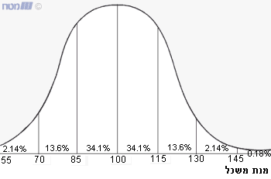
Definition of gifted:
Gifted are the ones who hold the 3 highest percentiles of assessed intelligence (I.Q.) in the broad population. Excellent are the one holding the 92-97 percentiles.
I.Q. = Heritage (40%) + Environment (40%) + Heritage/environment (20%).

Slide 20
Population, sources, social values - 1:
Potentially the gifted children are spread equally at the general population.
The last point where we will find equality is birth.
Stronger and more educated parents produce more gifted children.
There is extreme impact to the environment where a child grows and the potential to become gifted.

Slide 21
Population, sources, social values - 2:
A child coming from a nurturing environment will have a significantly higher chance to develop his potential.
The social value of equal chance and equal approach to quality education forces us to trace the potential gifted children and as soon as it is possible and supply them with the accessibility to processes that will allow them to nurture.

Slide 22
Where would we find the gifted?
The gifted children grow in all layer of society.
What makes the difference is accessibility to the evaluation process that define a child as gifted.

Slide 23
What is the social infrastructure of the gifted?
A gifted child grows best in a regular family with good enough parents that are functioning and are significant parental figures.
Gifted are most frequently found in families that are more educated and see education as a significant part of development.
Gifted will nurture more if provided exposure to new and wide knowledge and a better accessibility to this knowledge.

Slide 24
Characteristics of families that gifted are growing in:
Families with meaningful parental figures and role models.
Giving appreciation and meaning to education and learning.
Parents demonstrating assertiveness, decision taking, flexibility, creativity openness to discuss and open to criticism.
Meaningful siblings.
Appreciating clean language and clean and organized housing.

Slide 25

The gifted arena
Measuring, testing and identifying the gifted child

Slide 26
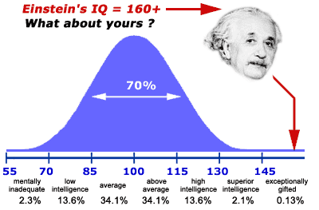

Slide 27
Understanding assessment
Assessment is a way of testing performance against a set of criteria.
There are difference tools and approaches to assess people, all design to give answer a certain characteristic of a given person.
As much as a more accurate result is desired the test is more detailed.
Accurate assessment is achieved using various and different means of testing.
Assessment can be informal to check progress or formal to confirm achievement.

Slide 28
I.Q. – Intelligent quotient:
Alfred Binet (1857-1911) invented the term IQ. He focused on verbal abilities. It identifies mental retardation in school children, but in specific contradistinction to claims made by psychiatrists that these children were "sick" (not "slow") and should therefore be removed from school. The score on the Binet-Simon scale would reveal the child's mental age in comparison to chronological age.

Slide 29
General assessment tools, known and modern
In general, two groups of tests are used
  Personality tests – aimed to assess behaviors, feelings and perceptions.
  Intelligence tests – aimed to quantify segments of human intelligence
In testing personality, we identify three groups of tests:
  Projection tests (like TAT, Ink Blots, evaluation cards).
  Self-reporting inventory (Big 5 personality traits – NEO240, MMPI).
  Group dynamics – the person tested given a mission as part of a group and being observed.

Slide 30
In testing intelligence, we identify 2 major parts
  Verbal intelligence (parts of Wechsler, parts of Stanford-Binet)
  Operational intelligence (like, parts of Wechsler, Raven).
Modern testing tool consist with two revolutionary approaches
  Using newly designed assessment cards for projection of personality
  Using known box games to test intelligence (like Tangram)

Slide 31
Assessing children from age 3 to 7
Psychological approach:
Children are yet soft, depended and easy to be influenced.
Are not able yet to plan their future.
Are biased by parental desired and easy to be manipulate.
Frustration threshold is very low.
Consent to cooperate variate due to internal and external disruptions.

Slide 32
Tools used + practice
For precise results you might use WIPSSI (Wechsler Preschool and Primary Scale of Intelligence) or Binet battery of tests.
Kindergarten teachers and teachers' testimonials after being trained to practice differential diagnosis.
Games based on understanding instructions, speed and motivation.
Evaluative cards aimed to reflect desired characteristics.

Slide 33
Assessing children from age 7 to 12
Psychological and social approach
  The pupil is ready to be tested after being preliminary observed.
  The pupil rules the language he is tested with.
  The pupil understands the reason he is tested, the consequences of failure as well of the ones of success.
  His family of origin support him being tested and knowledgeable to the consequences and the sacrifice they will have to give and the support they will have to receive and give.

Slide 34
Main tools used + practice:
  Precise tools – WAIS
    Verbal comprehension – the ability to learn a language, organize information through language, to draw, to define, to deduct, to conclude and create terms.
    Working memory – attention function, the ability to preserve newly learned information in the STM (Short term memory) through the verbal channel and be able to manipulate it.
    Perceptual organization – visual perception, spatial organization, analysis, synthesis, learning with minimum verbal arbitration.
    Processing speed – attention, speed of learning in real-time, how fast the subject internalizes a new rule and activates it.
  b. Evaluative, non-direct tests:
    1) TANGRAM
    2) Evaluative cards

Slide 35
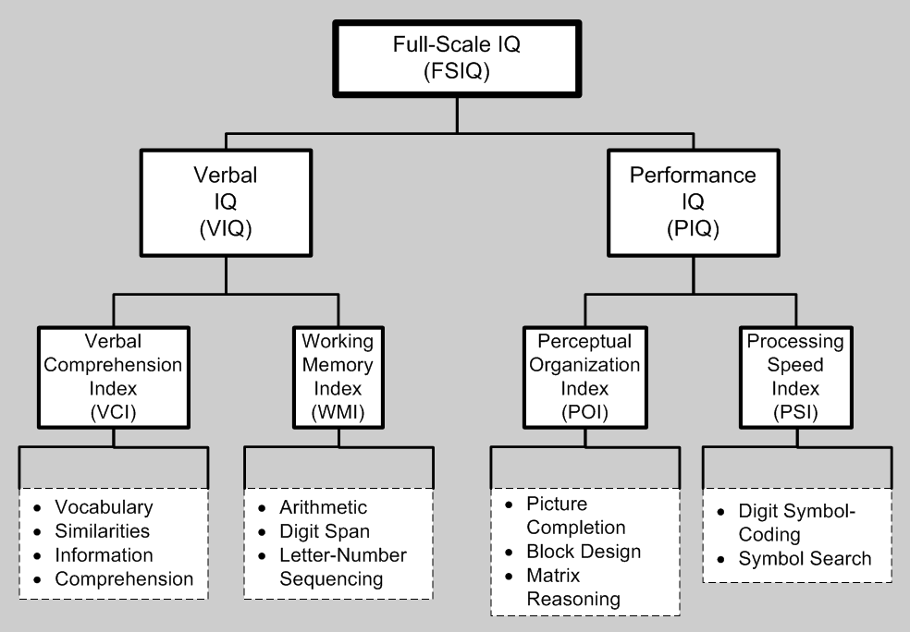

Slide 36
Assessing children above12 years old
Psychological and social approach
  The pupil is mature enough to be able to cope with frustration while going through longer processes and evaluation.
  The pupil is in the process of shaping his future, therefor very attentive to processes that might brighten this future.
  The pupil has relatedly significant life experience and should already develop and autonomous judgement system and internal values.
2. Main tools + practice
  Precise – WAIS, Raven
  Evaluative – MMPI, NEO240, cards

Slide 37

The gifted arena
The characteristics, behaviors and sociability of the gifted child along his maturation period.

Slide 38
Emotions and emotional development:
If your child is gifted, you might notice that they have very strong emotions, interests and opinions compared with other children their age. Sometimes gifted children have trouble managing these strong feelings.
For example, a young gifted child might be very upset when their drawing isn’t as ‘good as the one in the book’. A school-age child might worry more than others about friendship troubles or not always getting things ‘right’ in class. Older children might feel anxious about not being able to fix climate change. Or they might be extremely excited about a work of art and not understand why others don’t feel the same way.

Slide 39
Emotions and emotional development:
Strategies for handling strong feelings in gifted children

Slide 40
Social development and skills: gifted children:
Gifted children can think faster and/or more deeply than other children their age. So, they’re often good at imagining what it’s like to be in somebody else’s situation.
Sometimes these qualities mean your gifted and talented child gets along well with others. Other times, it might seem like your child doesn’t quite fit in with children their own age.
Also, you might have noticed that your gifted child prefers to play or be with older children. This is because your child is thinking and feeling at a similar level to older children.

Slide 41
Social development and skills
Strategies for helping gifted children get along with others

Slide 42
Behavior: gifted children:
Like all children, gifted and talented children can behave in challenging ways sometimes. But their challenging behavior can happen for reasons.
For example, it can happen because they:
are quick to question family rules and routines
are easily frustrated
need challenging learning opportunities.

Slide 43
Behavior
Strategies for managing family rules and routines
Strategies for handling frustration
Strategies for finding the right learning opportunities

Slide 44

The gifted arena
What can be expected from the identified gifted child in terms of academic abilities, learning pace, learning difficulties?
(Based on Dr. Colm O’Reilly Dublin City University)

Slide 45
What can be expected -1:
Shows superior reasoning powers and marked ability to handle ideas; can generalize readily from specific facts and can see subtle relationships; has outstanding problem-solving ability.
Shows persistent intellectual curiosity; asks searching questions; shows exceptional interest in the nature of man and the universe.
Has a wide range of interests, often of an intellectual kind; develops one or more interests to considerable depth.

Slide 46
What can be expected -2:
Is markedly superior in quality and quantity of written and/or spoken vocabulary; is interested in the subtleties of words and their uses.
Reads avidly and absorbs books well beyond his or her years.
Learns quickly and easily and retains what is learned; recalls important details, concepts and principles; comprehends readily.

Slide 47
What can be expected -3:
Shows insight into arithmetical problems that require careful reasoning and grasps mathematical concepts readily.
Shows creative ability or imaginative expression in such things as music, art, dance, drama; shows sensitivity and finesse in rhythm, movement, and bodily control.

Slide 48
What can be expected -4:
Sustains concentration for lengthy periods and shows outstanding responsibility and independence in classroom work.
Sets realistically high standards for self; is self-critical in evaluating and correcting his or her own efforts.
Shows initiative and originality in intellectual work; shows flexibility in thinking and considers problems from a number of viewpoints.

Slide 49
What can be expected -5:
Observes keenly and is responsive to new ideas.
Shows social poise and an ability to communicate with adults in a mature way.
Gets excitement and pleasure from intellectual challenge; shows an alert and subtle sense of humor.

Slide 50


Slide 51

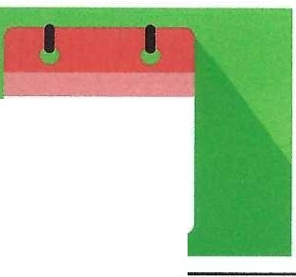
^{G},,,,^{A},..^{T},,^{E}_
rosur,onGlmlt
ANDTMOITTDm.lXmt
■Fundedby
theEuropean Union
GATE dissemination workshop
October 17-21, 2022
Kaw1as Lithuania
Seminar by
Dr. Yehuda Hamovitz
■Fundedby
theEuropean Union
GATE dissemination workshop
Workshop's program
Day 1 - The gifted arena.
Day 2 -The image of the gifted children's teacher. Day 3 -Learning strategies and assembling a Leeson.
Day 4 - Pa1ticipants give monitored and feedbacked lessons. Day 5 -Teachingtechaiquesand learningstrategies.
2
GATE
W<>OmMK
IIDGMl+llfflSW'l'OlfQFTID
-llllDfflDSTUDIIJffl
■Fundedby
theEuropean Union
The gifted arena
DAY
1
3

Slide 52

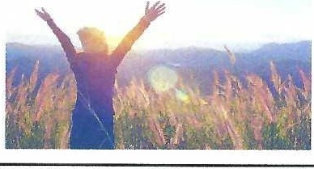

■Fundedby
theEuropeanUnion
The gifted arena
Purposes and targets of the workshop. Definitions of giftness.
Measuring, testing and identifying the gifted child.
The characteristics,behaviors and sociability of the gifted child along his maturation period.
What can be expected from the identified gifted child in terms of academic abilities, learning pace, learning difficulties?
4
-­
GATE
■Fundedby
theEuropeanUnion
PlOGtAMHETOSUl'f'Ot'fGlntt>
IIINl)Tlll.(NltDffl.lDIENT}
The gifted arena
Purposes and targets of the workshop
5
■Fundedby
theEuropean Union
Main objective of the overall project:
l. Build a national program that will trace, select,teach and educatethe gifted children living in the countiy.
2. Giving children fromall layersof societya fair and
equal chance to bringforward their qualities and abilities.
3. Developa perception of personal excellence, moral and social responsibilityaside involvement and personal commitment to the environment and to the other.
6

Slide 53
GATE
1'W}lUJT..........:
lO Gm:D
MI01'Jlll.()fflOSTUOfNl1
■Fundedby
theEuropean Union
Main components of the program:
1. Promote nurturing programs thatanswercognitive, emotional,
social and moral needsand aspects of the gifted throughout the years.
2. Trace and select gifted and excellent pupilsand referring them to the adequate program suitingthem and their needs.
Develop research and assessment toolsto evaluate the program and its successwhile developing cooperation with
other developed countries.
Develop training and courses for teachers who will teachthose giftedchildren allowing themto extract their higher potential.
7
-­
GATE
---
■Fundedby
theEuropeanUnion
N'OaNMET0$1Jff'01Tr.l'TtO
Main values of the program:
1. Leading and awarding a culture in which excellence is a central
value.
Simultaneous obligation to personal excellence, self-abnegation and mobility while the creation of learning environment that is creative, flexible and dynantic. Striving to promote challenging dialogs and continues creation of new knowledge.
Alearning community in which pupils and teachers are equal in their obligation and curiosity to new knowledge and field of expertise.
Enhancing the range of aspects of consciousness, to express their unique skills and to create appropriate learning and education patterns while constantly innovating.
8
-­
GATE
■Fundedby
theEuropean Union
PIOGt#MTO GITIO
""""""""""""
What is theimage of the graduate?
1. Become excellent in science, technology, art,literature, law, business,philosophyand entrepreneurship.
Demonstrate perseverance and persistence, creativity and otigtnaucy, curtostcy, lntellecrual and/or art1st1c honesty, ability and desire toconstantly learn and developabilityto think and act under conditions of uncertainty.
Demonstrate multidirectional thinking, interdisciplinaryvision, analytical ability, efficient information conswnption, broad vision and awarenessof value implications.
Agraduate of the unique programs must be a person with a social commitment and a high level of moralityand hwnanity.
9

Slide 54

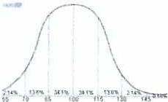
-­
GATE
■Fundedby
theEuropean Union
PIOGMIMTI)S\WOtfGf'l'fD
NtPTII.Ofllot!UlUm
The gifted arena
Definitions of giftness
IFTED
10
GATE
WoOCIISl..,._
TOSl.ffOl:TQfTRI
NCllllWlltDm.atm
Definition of gifted:
Fundedby
theEuropean Union
Gifled are the ones who hold the 3 highest percentiles of assessed intelligence (f.Q.) in the broad population. Excellent are the one holding the 92-97 percentiles.
I.Q. - Heritage (40%) + Environment (40%) + Heritage/environment (20%).
11
G_A,_TE
■Fundedby
theEuropean Union
noaNMIOSUPPQITCMlfO
NtD m.eum
Population, sources, social values - 1:
Potentially the gifted children are spread equally at
the general population.
The last point where we will find equality is birth.
Stronger and more educated parents produce more gifted children.
There is extreme impact to the environment where a child grows and the potential to become gifted.
12

Slide 55


GATE
li.llOHSTtANNC;
TOMtOCTalltl
IINOlfllINT(PSTU:lllffl
■Fundedby
theEuropeanUnion
Population, sources, social values - 2:
I. A child coming from a nurturing environment will
have a significantly higher chance to develop his potential.
2. The social value of equal chance and equal approach to quality education forces us to trace the potential gifted ch.ildren and as soon as it is possible and supply them with the accessibility to processes that will allow them to nurture.
■Fundedby
theEuropean Union
Where would we find the gifted?
l. The gifted children grow in all layer of society.
2. What makes the difference is accessibility to the evaluation process that define a child as gifted.
13
14
■Fundedby
theEuropeanUnion
What is the social infrastructure of the gifted?
I. A gifted child grows best in a regular family with good
enough parents that are functioning and are significant
parental figures.
Gifted are most frequently found in families that are
more educated and see education as a significant part of development.
Gifted will nurture more if provided exposure to new and wide lrnowledge and a better accessibility to this
knowledge.
15

Slide 56


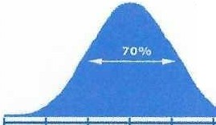

-­
GATE
■Fundedby
theEuropean Union
ltOQNNlOSUf'JOtTGflU)
MDlJIUHnDfllJDOm
Characteristics of families that gifted are growing in:
I. Families with meaningful parental figures and role models.
Giving appreciation and meaning to education aud learning.
Parents demonstrating assertiveness, decision taking, flexibility, creativity openuess to discuss and open to criticism.
Meaningful siblings.
Appreciating clean language and clean and organized housing.
16
■Fundedby
theEuropean Union
The gifted arena Measuring, testing and identif)ing the gifted child
17
G_,_ATE
NIX.INtHlfOSl.nmf(#ffi)
W,(j(Jil)mmoffl
■Fundedby
theEuropean Union
E/nfteln'• IQ= 160+ _...,
What about yours ?
., \.;
⁵.⁵::=⁷.⁰...,.,_⁸⁵ -. ¹⁰⁰.-.::;.¹¹....⁵.z.¹.³⁰:::.¹⁴·⁵
2 3% 13.6% 3-1.1% 34.1% 13.6% 2.1% 0.13'K
18

Slide 57

-­
GATE
■Fundedby
theEuropean Union
T0l\lff'O«TC'6110
"'"'"'<JR>"""'"'
Understanding t1ssessmenl
I. Assessment is a way of testing performance against a set of criteria.
There are difference tools and approaches to assess people, all design to
give answer a certain characteristic of a given person.
As much as a more accurate result isdesired the test is moredetailed.
Accurate assessment is achieved using various and different means of
testing.
Assessment can be informal to cheek progress or formal to confinn achievement
■Fundedby
theEuropean Union
1.Q. - Intelligent quotient:
Alfred Binet (1857-1911) invented the tenn IQ. He focused on verbal abilities. lt identifies mental retardation in school children, but in specific
contradistinctionto claims made by psychiatrists that these children were "sick" (not "slow'') and should therefore be removed from school. The score on the Binet-Simon scale would reveal the child's mental age in comparison to chronological age.
19
20
GATE
T(A()nS,-.:
■Funded by
'1IIXl#K10SIJPPOIT
theEuropeanUnion
"""'"""""""""
General assessment tools, known and modern
I. In general, two groups of tests are used
a Personality tests- aimed to assess behaviors, feelings and perceptions.
b. Intelligence tests - aimed to quantify segments of human intelligence
In testing personality, we identify three groups of tests:
  Projection tests (likeTAT, Ink Blots, evaluation cards).
  Self-reporting inventory (Big 5 personality traits - NEO240, MMPI).
  Group dynamics -the person tested given a mission as part of a
group and beingobserved.
21

Slide 58


!!
Fundedby
l'IOWlfNlOSl.ffOtTG¥Tftl
Nrl)lJ[UNffl)m.i:,,om
theEuropeanUnion
I. In testing intelligence, weidentify 2 major parts
Verbal intelligence (parts of Wechsler, parts of Stanford-Binet)
Operational intelligence (like, parts of Wechsler, Raven).
2. Modern testing tool consist with two revolutional)' approaches
Using newly designed assessment cards for projection of
personality
Using known box games to test intelligence (like Tangram)
22
■Fundedby
theEuropean Union
Assessing children from age3 to 7
Psychological approach:
l. Children are yet soft, depended and easy to be influenced.
Are not able yet to plan their future.
Are biased by parental desired and easy to be manipulate.
Frustration threshold is very low.
Consent to cooperate variate due to internal and external disruptions.
■Fundedby
theEuropeanUnion
Tools used+ practice
l. For precise results you might use WlPSSJ (Wechsler Preschool and Primary Scale oflntelligence) or Binet battery of tests.
Kindergarten teachers and teachers' testimonials after being
trained to practice differential diagnosis.
Games based on understanding instructions, speed and motivation.
Evaluative cards aimed to reflect desired characteristics.
23
24

Slide 59

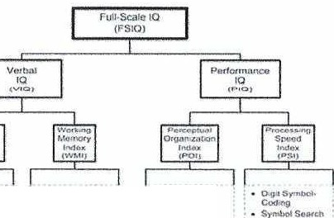
GATE
ltllQOST
l'IQGIMMTOSV'f(lf;TQJl(I>
N<IDTJlllfJfllOU\ll(NTI
■Fundedby
theEuropun Union
Assess:nc d1:ldrcn from llge, t·o 11
Psychological and social approach
  The pupil is ready to be tested after being preliminary observed.
  The pupil rules the language he is tested with.
  The pupil understands the reason he is tested, the consequences of failure as well of the ones of success.
d His family of origin support hi.m being tested and knowledgeable to
theconsequences and the sacrifice they willhave to give and the
support they will have to receive and give.
25
-IIIN)Dll.D­(IU)f1\10Uffi
GATE
■Fundedby
theEuropean Union
,_,.,,.....10"-"'CtJ<ilHfD
Main tools used+ practice:
  Precise tools - WAIS
    Verbal comprehension - the ability to learn a language, organize
infonnation through language, to draw, to define, to deduct, to conclude and create terms.
    Working memory- attention function. the ability to preserve newly learned information in the STM (Short term memory) through the verbal channel and be able to manipulate it.
    Perceptual organi7.ation - visual perception, spatial organization,
analysis, synthesis. learning with minimum verbal arbitration.
    Processing speed - attention, speed of learning in real-time, how
fast the subject internalizes a new rule and activates it
b. Evaluative, non-direct tests:
I) TANGRAM
2) Evaluative cards
26
■Fundedby
theEuropeanUnion
·-·
\ro,t,,.I
-
<;(ln1f)f0ft•,U-'(jf'I
""'"
·--
l',r;-·
\/(M.
S-<n
lrwbrn,,1,iCtn
Coro °'
o.i,1si-
.........
Ler.or.J,lvonmt
8j)ct0ti.git
.........
27

Slide 60
GATE
ll#IQt'tSTll\ll'N,
1"0C'.l/lHMfTOSUN'OtlGflfl)
Nil)llllDIT(D!TUD(lffl
■Fundedby
theEuropeanUnion
Assessing children above12 years old
Psychological and social approach
  The pupil ismature enough to be able to cope with Jh.istration while
going through longer processes and evaluation,
  The pupil is in the process ofshaping his future, therefor very
attentive to processes that might brighten this future.
  The pupil has relatedly significant lifo experience and should already
develop and autonomous judgement system and internal values.
Main tools+ practice
  Precise- WAJS, Raven
  Evaluative - lvlMPI, NEO240, cards
28
-­
GATE
■Fundedby
theEuropean Union
TI) Qf'T[D
,v,;l)l ml)ftffl
The gifted arena
The characteristics, behaviors and sociability of the gifted child along his maturation period.
CHARACTERISTIC
■Fundedby
theEuropean Union
29
-­
GATE
lO urm,
"""'"'"'°"""""
Emotions and emotional development:
If your child is gifted, you might notice that they have ve1y
strong emotions, interests and opinions compared with
other children their age. Sometimes gifted children have trouble managiug these strong feelings.
For example, a young gifted child might be very upset when their drawing isn't as 'good as the one in the book'. Aschool-age child might worry more than others about friendship troubles or not always getting things 'right' in class. Older children might feel anxious about not being able to fix climate change. Or they might be extremely excited about a work of art and not understand why others don't feel
the same way.
30

Slide 61

-MIOTIUHTtPm.oam­
GATE
■Fundedby
theEuropeanUnion
'10GINMTIJK.ffOIT(j,fT[D
Emotions and emotional
development:
Strategies for handling strong feelings in gifted children
31
GATE
■Fundedby
theEuropean Union
ft">"Slf"t''O"IT­QJTD
AICITl!lftffl05f\lC'if,N1S
Social development and skills: gifted children: Gifted children can think faster and/or more deeply than other children their age.So, they're often good at imagining what it'slike to be in somebody else's situation.
Sometimes these qualities mean your gifted and talented child getsalong well with others. Other times, it might seem like your child doesn't quite fit in with children their own age.
Also, you might have noticed that your gifted child prefers to play or be with older children. This is because your child is thinkingand feeling at a similarlevel to older children.
32
Fundedby
theEuropean Union
Social development and skills
Strategies for helping gihed children get
along with others
33

Slide 62


-IINOTIU!'flU>fTUtl­ (Jffl
GATE
■Fundedby
J't0WllffT0"""°'1c.rnP
lheEuropeanUnion
Behavior: gifted children:
Like all children, gifted and talented children can behave in challengingways sometimes. But their challenging behavior can happen for reasons.
For example, it can happen because they:
are quick to question family rules and routines are easily frustrated
need challenging learning opportunities.
■Fundedby
theEuropeanUnion
34
Behavior
Strategies for managing family rules and routines Strategies for handlingfrush·ation
Strategies for finding the right learning opportunities
■Fundedby
theEuropeanUnion
35
The gifted arena
What can be expected from the identified gifted child in terms of academic abilities, learning pace, learning difficulties?
(Based on Dr. Colm O'Reilly Dublin City University)
€XP€CTATLONS
-
36

Slide 63


A]!
■Fundedby
theEuropeanUnion
PIOlilAMMET05Ull'OfTQFflD
... 1'Wlm>m.oom
What can be expected -1:
Shows superior reasoning powers and marked abilityto handle ideas; can generalize readily from specific facts and can see subtle relationships; has outstanding problem-solvingability.
Shows persistent intellectual curiosity; asks searching questions; shows exceptional interest in the nature of man and the universe.
Has awide range of interests, often of an
intellectual kind; develops one or more interests to considerable depth.
37
■Fundedby
theEuropeanUnion
What can be expected -2:
Is markedly superior in quality and quantity of written and/or spoken vocabulary; is interested in the subtleties of words and their uses.
Reads avidly and absorbs books well beyond his or
her years.
Learns quickly and easily and retains what is learned; recalls important details, concepts and principles; comprehends readily.
■Fundedby
theEuropean Union
What canbe expected -3:
Shows insight into arithmetical problems that
require careful reasoning and grasps rn.a-thematical
concepts readily.
Shows creative ability or imaginative expression in such things as music, art, dance ,drama; shows sensitivity and finesse in rhythm, movement, and bodilycontrol.
38
39

Slide 64


G_,_ATE
'90QNMlOSl#'POfl"Qflfl)
IIHDTMINfll>Sl'\IDllffli
■Fundedby
theEuropean Union
What can be expected -4:
Sustains concentration for lengthy periods and shows outstanding responsibilityand independence in classroom work
Sets realistically high standards for self; is self­ critical in evaluating and correcting his or her own efforts.
Shows initiative and originality in intellectual work; shows flexibility in thinking and considers
problems from a number of viewpoints.
40
-­
GATE
■Fundedby
theEuropean Union
lOSUl'f'OlfGrn'II
NCJTN.umonwnns
What can be expected -5:
Observes keenly and is responsive to new ideas.
Shows social poise and an ability to communicate with adults in a mature way.
Gets excitement and pleasure from intellectual challenge; shows an alert and subtle sense of humor.
■Fundedby
theEuropean Union
41
42

Slide 65
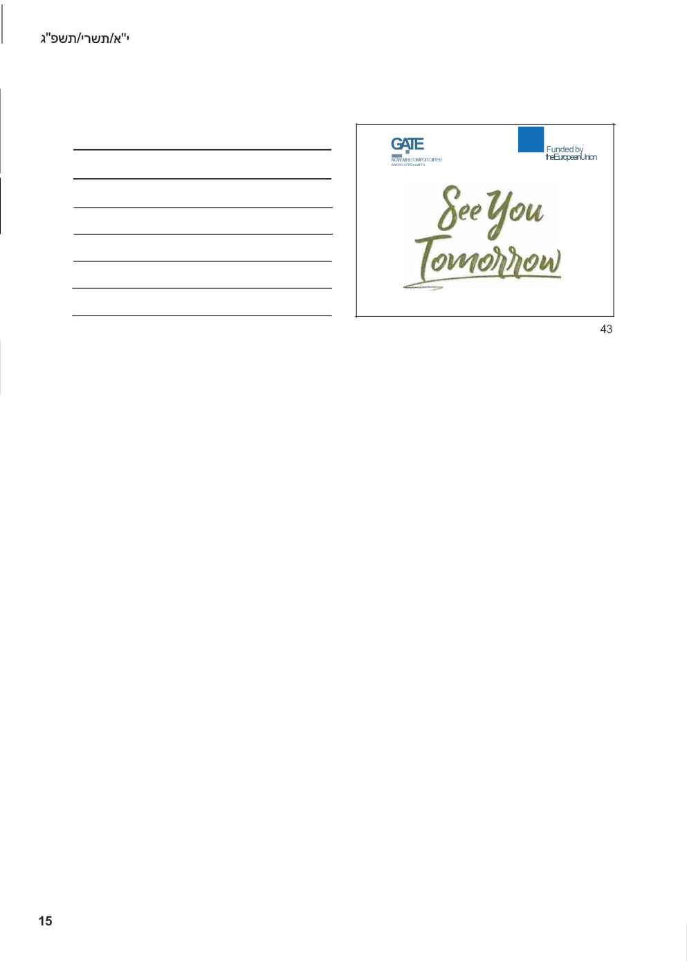

Slide 66


Slide 67
GATE project 1st Learning, Teaching and Training Activity (LTTA)
October 17-21, 2022
Kaunas Lithuania
Seminar by
Dr. Yehuda Hamovitz

Slide 68
GATE dissemination workshop
Workshop’s program
Day 1 – The gifted arena.
Day 2 - The image of the gifted children's teacher.
Day 3 –Learning strategies and assembling a Leeson.
Day 4 - Participants give monitored and feedbacked lessons.
Day 5 - Teaching techniques and learning strategies.

Slide 69

The image of the gifted children's teacher

Slide 70
The image of the gifted children's teacher
Foundation of the adequate teacher for gifted children.
Characteristics of the teacher: background and education. Models identifying the effective teacher.
Professional and didactic abilities of the teacher.
Closing gaps – evolving from a classic teacher to a gifted one.
The gifted classroom – understanding and applying.
The gifted classroom and a natural development arena.

Slide 71

The image of the gifted children's teacher
Foundation of the adequate teacher for gifted children

Slide 72
Foundation of the adequate teacher for gifted children
One who is not afraid from this mission.
Present a strong and firm personality.
Have the desire to learn and develop.
Allows itself to be involved in all life aspect of the pupil.
Well educated, well trained and with access to multiple sources of information.

Slide 73
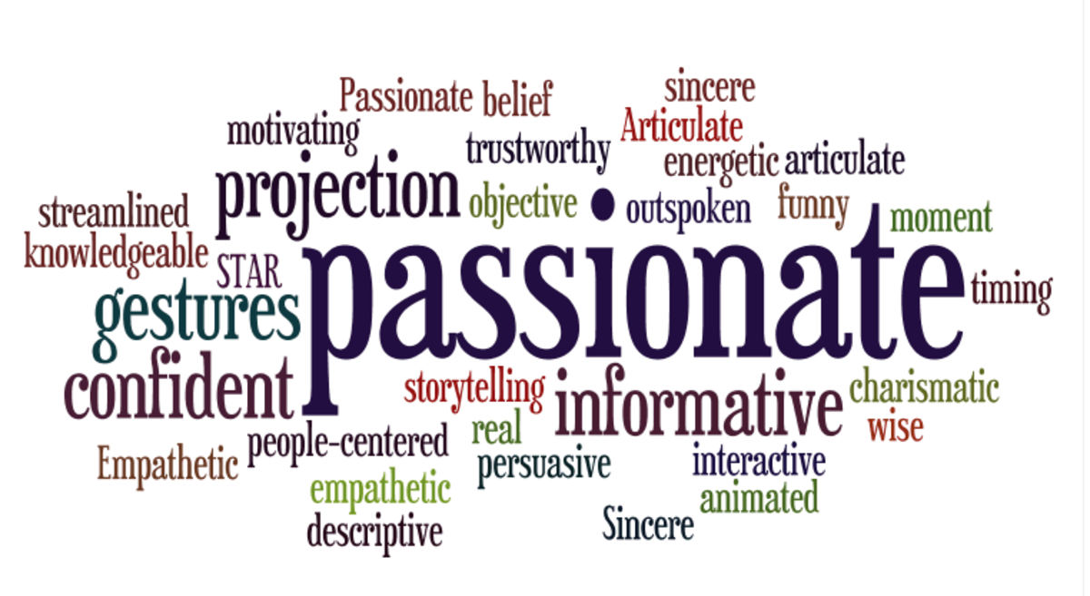
The image of the gifted children's teacher
Characteristics of the teacher: background and education.

Slide 74
Characteristics of the teacher: background and education.
A young enough teacher that will be perceived by the pupils as partner for studying and less a parent.
Enthusiastic to learn, able to admit not knowing.
Strong and stable personality, assertive, humble, tactful.
Can see the big picture, future orientation

Slide 75

The image of the gifted children's teacher
Models identifying the effective teacher.

Slide 76
12 characteristics for the effective teacher for gifted children: (Hultgren & Seely 1982)
Mature, experienced and self-secured.
Holder higher intelligence.
Interested in a wider scope of intellectual knowledge.
Achievement pro.
Has a sympathetic attitude toward gifted children.
Systematic and orderly.

Slide 77
12 characteristics for the effective teacher for gifted children: (Hultgren & Seely 1982)
Alarming and imaginative.
Has a sense of humor.
Can assist in learning without giving instructions and directing.
Understanding the necessity to work harder.
Has broad general knowledge and expertise.
Recognizes interpersonal differences.

Slide 78
What Do Students Look for in a “Good” Teacher? (M. Khalil & Z. Accariya 2016)
The qualities and skills of a good teacher can be divided into two distinct categories: professional-pedagogical and personal-emotional.
Professionally, good teachers are:
    authorities in their field
    capable of stimulating their students
    developing their intellectual abilities.

Slide 79
What Do Students Look for in a “Good” Teacher? (M. Khalil & Z. Accariya 2016)
Pedagogically, good teachers are:
  demonstrate originality and creativity,
  furnish a personal example to their students,
  guide and encourage the development of intellectual curiosity and learning motivation among their students.
  able to expresses their ideas simply and understandably.

Slide 80
What Do Students Look for in a “Good” Teacher? (M. Khalil & Z. Accariya 2016)
On the personal-emotional side:
  good teachers have the attributes of good parents.
  they are sensitive, concerned, attentive, understanding, encouraging, and supportive.

Slide 81
Good Teachers: (Avinon 2004)
A good teacher is brave, honest, and affectionate, and demonstrates self-respect, self-awareness, individual responsibility, imagination, improvisation skills, and a sense of humor.
Such personality traits enable development of a personal relationship between students and teachers in which teachers are transformed into mentors-educators who strive to stabilize the identity, world- view, and life values of their student.

Slide 82

The image of the gifted children's teacher
Professional and didactic abilities of the teacher

Slide 83
Professional and didactic abilities of the teacher
Becomes an expert in the subjects one teaches.
Motivated to look for new and advanced learning materials and learning options and sources.
Uses many different and multiple teaching skills and techniques.
Builds curricula and set goals (KPI – Key Performance Indicators) for achievement.
Assist in selecting sources of information.
Develop the product and make assessments

Slide 84
Professional and didactic abilities of the teacher
The gifted teacher should know how to:
(Alleducationschools.com 2022)
Design a curriculum that addresses the cognitive, physical, emotional and social needs of gifted students
Create assignments/activities for gifted learners with different levels of ability rather than a one-size-fits-all approach.
Be flexible in all things and try to turn unexpected circumstances into learning opportunities.

Slide 85
Professional and didactic abilities of the teacher
The gifted teacher should know how to:
Permit students to take on individual projects based on their own interests.
Allow students to work ahead at their own pace, and stress learning skills like researching and questioning rather than rote memorization and regurgitation.
Make as much of your curriculum as possible interactive, either between the students and the teacher, or between the students themselves.

Slide 86
Professional and didactic abilities of the teacher
The gifted teacher should know how to:
Explore the real world and contemporary issues in the classroom. Don’t be afraid to state opinions and encourage debate.
Bring other educators into the classroom to expand learning opportunities for students.
Encourage gifted students from other grade levels and schools to interact.
Promote extracurricular activities with an intellectual focus.

Slide 87
Professional and didactic abilities of the teacher
The gifted teacher should know how to:
Allow students to set individual goals and encourage them to be ambitious.
Incorporate insights and advice offered by the parents of gifted students.
Do not place too much pressure on gifted students or set expectations too high.
Provide counseling when necessary.

Slide 88
Professional and didactic abilities of the teacher
The gifted teacher should know how to:
Acknowledge that students who are gifted in one area may struggle in another.
Avoid giving extra in-class work or homework to students who finish early. Even gifted kids interpret this as an unfair punishment.
Offer lots of opportunities for gifted kids to socialize with each other and with other students in the school.

Slide 89
Professional and didactic abilities of the teacher
The gifted teacher should know how to:
Provide supplementary learning tools that students can pursue at their own direction.
Honor the differences of your students and look for what makes each child unique beyond his or her intellectual abilities.

Slide 90

The image of the gifted children's teacher
Closing gaps – evolving from a classic teacher to a gifted one

Slide 91
Closing gaps – evolving from a classic teacher to a gifted one
Perceiving and embedding the change in power relations between the teacher and the pupil, from more authoritarian to a partner to self-development.
Perceiving the need to widen the scope of every subject learned and going deeper into details.
Thorough training both in pedagogic skills, professional skills and emotional skills.

Slide 92

The image of the gifted children's teacher
The gifted classroom: understanding and applying.

Slide 93
The gifted classroom: understanding and applying.
The gifted classroom should include the possibility of providing a comprehensive educational response to the gifted, focusing on their being well.
The ability of this class as an educational setting touching this topic optimally is derived from some of its characteristics:

Slide 94
The gifted classroom: understanding and applying.
Being a classroom within the school
The ability to produce a holistic view, based on the understanding that the cognitive aspect emphasized in the emotional aspect
The opportunity to produce the gifted classroom as a common development space for the individual pupil, the class and the teachers. dialog.

Slide 95
The gifted classroom: understanding and applying.
Gifted are identified based on their cognitive abilities and achievements. Their main expectations of their parents, teachers, and of their environment focuses on cognitive performance.
The central aspect in most gifted programs is the cognitive one. an emotional dialog.

Slide 96
The gifted classroom: understanding and applying.
Attempts to answer the emotional aspect as well is often reflected in external components of the program, such as emotional workshops or meetings with the counselor.
Those important components express a concept that separates the cognitive and emotional aspects.
Modern approaches emphasize the synchronization of the two aspects.

Slide 97
The gifted classroom: understanding and applying.
The gifted possess sharp cognitive tools like criticism, doubt and rationalization. Those tools that often lead them to their high achievement and appreciation from the environment.
The gifted are display those tools at the forefront of their struggles and sometimes as their business card in the world.

Slide 98
The gifted classroom: understanding and applying.
They use those cognitive tools to cope with the field of emotional c as a defense mechanism or as an attempt to understand the world.
This tendency often creates distortions in interpersonal communication.

Slide 99
The gifted classroom: understanding and applying.
By understanding those mechanisms, we can understand them the teacher can decide when to adopt this trend and use the cognitive path tools to gain access to their emotional arena that is, many times blocked or fenced.
The teacher can decide when to resist this trend and try to stimulate an emotional dialog.

Slide 100
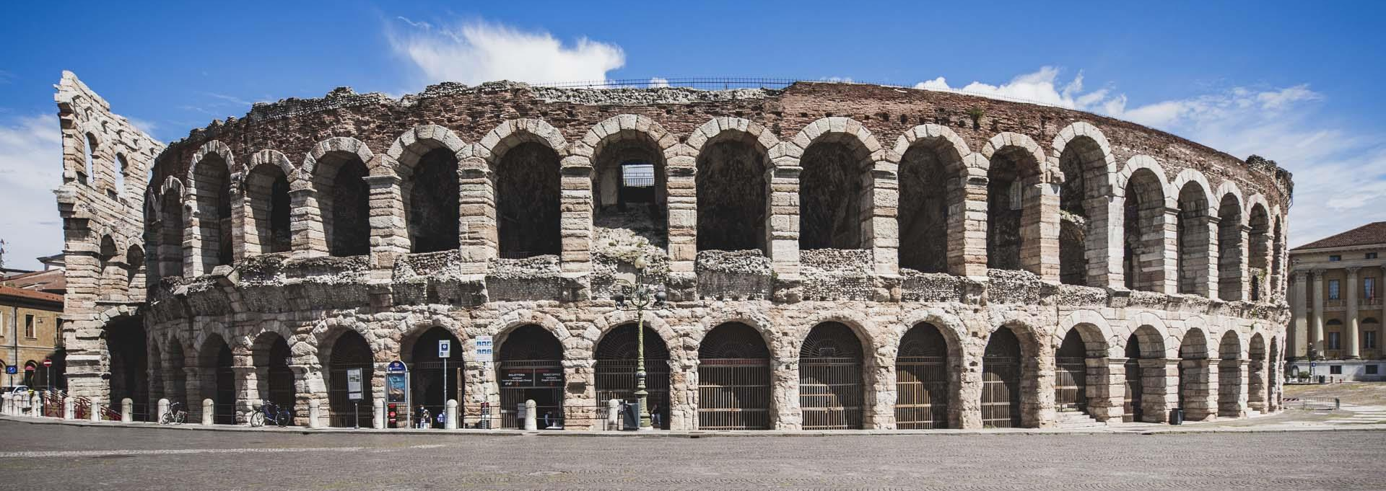
The image of the gifted children's teacher
The gifted classroom and a natural development arena

Slide 101
The gifted classroom and a natural development arena
The classroom is a space for common development for all sides, both the students and the teacher.
It is a place where growth is shared and relies on interdependence.
A space where everyone - pupils and teachers – learns and not just study material. They learn about themselves and about life as individuals, a team, a class, and a society.

Slide 102
The gifted classroom and a natural development arena
A gifted class should be a space of openness and trust - this is a challenge when it comes to gifted that are always critical, doubtful, and sometimes suspicious.
The class should be an opportunity to experience trust in a protected environment.
For the teacher it is an "open classroom door" giving the opportunity to be observed, assessed, mentored and given feedback.

Slide 103
The gifted classroom and a natural development arena
The gifted and the teachers are observing, watching, assessing and judging each one constantly, the classroom should become a secured place to understand it and to learn from it.
The classroom is a place where everyone might be wrong, the gifted and the teacher. Learning there is about what do we do with the mistake or the failure and how do we extract learning.

Slide 105


^{G}...^{A}.,^{T}.,_^{E}
_lO..M...'.fQ,..l'.f.<,.i.lf.lUJ
■^{Funded}Europeanthe ^{by} Union
GATE project 1st Learning, Teaching
and Training Activity (LTIA)
October 17-21, 2022
Kaunas Lithuania
Seminar by
Dr. Yehuda Hamovitz
■^{Funded}European^{by}the Union
GATE dissemination workshop
Workshop's program
Day 1 - The gifted arena.
Day 2 - The image of the gifted children's teacher. Day 3 -Learning strategies and assembling a Leeson.
Day 4 - Participants give monitored and feedbacked lessons.
Day 5 - Teaching techniques and learningstrategies.
2
-NCTiilt.fJ{J'-(­DJT\JC811l
GATE
■^{Funded}Europeanthe ^{by} Union
l'IIOCi#lloMlO <.nlD
The image of the gifted
children's teacher
2
3

Slide 106

-­
GATE
■Fundedby
theEuropeanUnion
TOOJnOIT"TIO
N<IOTAl.OfflOIT\llOO'S
The image of the gifted
children's teacher
Foundation of the adequate teacher for gifted children. Characteristics of the teacher: background and education. Models identifying the effective teacher.
Professional and didactic abilities of the teacher. Closing gaps- evolving from a classic teacher to a gifted
one.
The gifted classroom - understanding and applying.
The gifted classroom and a natural development arena.
■^{Funded}theEuropean^{by} Union
The image of the gifted children's teacher
Foundation of the adequate teacher for gifted children
4
'. ·TRONG
S
IFUNDADl"T\ON
5
--­#IOTMVmOSTIJbl)ffl
GATE
■Funded by
lOWlfOt'JGl'f(O
theEuropeanUnion
Foundation of the adequate
teacher for gifted children
One who is not afraid from this mission. Present a strong and firm personality. Have the desire to learn and develop.
Allows itself to be involved in all life aspect of the pupil.
Well educated, well trained and with access to
multiple sources of information.
6

Slide 107
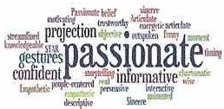


, GATE
■^{Funded}Europeanthe ^{by} Union
1'11%1NHTOSUPfOUQn'to
&IC>TN.IHTltlSTOOf'ffl
The image of the gifted
children's teacher
Characteristics of the teacher: background and education.
7
■^{Funded}Europeanthe ^{by} Union
Characteristics of the teacher:
background and education.
Ayoung enough teacher that will be perceived by the pupils as partner for studying and less a parent. Enthusiastic to learn, able to admit not knowing. Strong and stable personality, assertive, humble, tactful.
Can see the big picture, future orientation
8
--­
GATE
■^{Funded}Europeanthe ^{by} Union
lOQPOIT<lll(J
MD!N..EHTWSTI.UHTS
The image of the gifted
children's teacher
Models identifying the effective teacher.
9

Slide 108
-NtDTNUfTIOmapffi­
GATE
■Fundedby
theEuropean Union
WMIOSUPl'Oll""8>
12 characteristicsforthe effective teacher for
gifted children: (Hultgren &Seely1982) Mature, experienced and self-secured. Holder higher intelligence.
Interested in a wider scope of intellectual knowledge. Achievement pro.
Has a sympathetic attitude toward gifted children.
Systematic and orderly.
10
-­
GATE
■^{Funded}Europeanthe ^{by} Union
10M'f'Cl1'"Glfll0
oflfC)IIIWmOmJDENTS
12 characteristicsfor the effective teacher for gifted children: (Hultgren & Seely1982)
Alarming and imaginative.
Has a sense of humor.
Can assist in learning without giving instructions and
directing.
Understanding the necessity to work harder.
Has broad general knowledge and expertise. Recognizes interpersonal differences.
11
-­
GATE
■^{Funded}Europeanthe ^{by} Union
m>CilMttCl01UmJlfr.fltO
IUoOT""-!Nffl>STUCllN'T'S
What Do Students Look for in a "Good"
Teacher? (M. Khalil & Z.Accariya 2016)
The qualities and skills of a good teacher can be
divided into two distinct categories: professional­
pedagogical and personal-emotional. Professionally, good teachers are:
authorities in their field
capable of stimulating their students
developing their intellectual abilities.
12

Slide 109


■^{Funded}Europeanthe ^{by} Union
What Do Students Look for in a "Good"
Teacher? (M. Khalil & Z. Accariya 2016)
Pedagogically, good teachers are:
demonstrate originality and creativity,
furnish a personal example to their students,
guide and encourage the development of intellectual curiosity and learning motivation
among their students.
able to expresses their ideas simplyand
understandably.
■^{Funded}theEuropean^{by} Union
13
What Do Students Look for in a "Good"
Teacher? (M. Khalil & Z. Accariya 2016)
On the personal-emotional side:
good teachers havethe attributes of good parents.
they are sensitive, concerned, attentive,
understanding, encouraging, and supportive.
14
':'I§
■^{Funded}Europeanthe ^{by} Union
l'IOGMIH'roUf'Ol1C#TfO NC17"Dll10S'TUDOffS
Good Teachers: (Avinon 2004)
A good teacher is brave, honest, and affectionate, and demonstrates self-respect, self-awareness, individual responsibility,imagination, improvisationskills, and asense of humor.
Such personality traits enable development of a personal relationship between students and teachers in which teachers are transformed into mentors­ educators who strive to stabilize the identity, world­
view, and life values of their student.
15

Slide 110

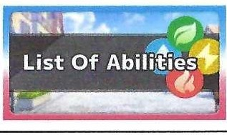

■^{Funded}Europeanthe ^{by} Union
The image of the gifted
children's teacher
Professional and didactic abilities of the teacher
16
^{G},,,^{A}.,.^{T}.,^{E}_
■^{Funded}Europeanthe ^{by} Union
IIIOGb'lloMltlR.W()ITGIR'[l)
-""""""""""
Professional and didactic abilities of the teacher
1. Becomes an expert in the subjects one teaches.
Motivated to look for newand advanced learning materials and learning options and sources.
Uses many different and multiple teaching skills and
techniques.
Builds curricula and set goals (KP! - Key Performance Indicators) for achievement.
Assist in selecting sources of information.
Develop the product and make assessments
17
■the^{Funded}European^{by} Union
Professional and didactic abilities
of the teacher
The gifted teacher should knowhow to:
(Alleducatiooschools.com 2022)
Design a curriculum that addresses the cognitive, physir,al,
emotional and social needs of gifted students
Create assignments/activitiesfor gifted learners with different levels of ability rather than a one-size-fits-all approach.
Beflexible in all things and try to turn unexpected
circumstances intolearningopportunities.
18

Slide 111



■^{Funded}Europeanthe ^{by} Union
Professional and didactic abilities
of the teacher
The gifted teacher should know how to:
Permit students to take on individual projects based on their own interests.
Allow students to workahead at their own pace, and stress learning skills like researching and questioning rather than
rote memorization and regurgitation.
Make as much of your curriculum as possible interactive,
either between the students and the teacher, or between the students themselves.
19
■Fundedby
theEuropeanUnion
Professional and didactic abilities of the teacher
The gifted teacher should know how to:
Explore the real world and contemporaty issues in the
classroom. Don't be afraid to state opinions and encourage debate.
Bringother educators into the classroom to expand learning opportunities for students.
Encourage gifted students from other gradelevels and schools to interact.
Promote extracurricular activities with an intellectual focus.
20
■^{Funded}Europeanthe ^{by} Union
Professional and didactic abilities
of the teacher
The giftedteacher should know how to:
Allow students to set individual goals andencourage them to
be ambitious.
Incorporate insights and adviceoffered by the parents of gifted students.
Do not place too much pressure on gifted students or set expectations too high.
Provide counseling when necessary.
21

Slide 112

^{G}n,^{A},,.^{T}..^{E}_
■Fundedby
theEuropeanUnion
NO<.tNMTOSUPHlnG!fTCO
'1HOlPWntom.arm
Professional and didactic abilities
of the teacher
The gifted teacher should know how to:
Acknowledge that students who are gifted in one area may struggle in another.
Avoid givfog extra in-class work or homework to students who finish early. Even gifted kids interpret this as an unfair
punishment.
Offer lotsof opportunities for gifted kids to socialize with each other and with other students in the school.
22
■^{Funded}Europeanthe ^{by} Union
Professional and didactic abilities of the teacher
The gifted teacher should know how to:
Provide supplementarylearning tools that studea ts can pursue at their own direction.
Honor the differences of your students and look for what
makes each ch.ild unique beyond his or her intellectual
abilities.
23
-
GATE
■^{Funded}Europeanthe ^{by} Union
lOSU'fOlll(;n'(O
-,1AU,mom.a,m
The image of the gifted
children's teacher
Closing gaps - evolving from a
classic teacher to a gifted one
, ,-,-...,.,.,r.,r.,r"'
MIND THEGAP
24

Slide 113

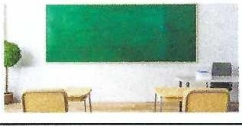
!!
■^{Funded}Europeanthe ^{by} Union
-TO-C";IFTlD
AfmlJIIUliffl>IT\IIUffl
Closing gaps - evolvingfrom a
classic teacher to a gifted one
Perceiving and embedding the change in power relations between the teacher and the pupil, from more authoritarian to a partner to self­ developrnent.
Perceiving the need to widen the scope of every
subject learned and going deeper into details. Thorough training both in pedagogic skills, professional skillsand emotional skills.
■^{Funded}theEuropean^{by} Union
The image of the gifted children's teacher
The gifted classroom: understanding and applying.
25
26
GATE
=,. urtXTQ'TUI
AADTM.IN1ll>STUOOl1'S
■Fundedby
theEuropeanUnion
The gifted classroom: understanding and applying.
The gifted classroom should include the possibility of providing a comprehensive educational response
to the gifted ,focusing on their being well .
The ability of this class as an educational setting
touching this topicoptimally is derived from some of its characteristics:
27

Slide 114


■^{Funded}Europeanthe ^{by} Union
The gifted classroom:
understanding and applying.
Being a classroom within the school
The ability to produce a holistic view, based on the
understanding that the cognitive aspect emphasized in the emotional aspect
The opportunity to produce the gifted classroom as a common development space for the individual pupil, the class and the teachers. dialog.
28
-­
GATE
■^{Funded}Europeanthe ^{by} Union
PiOQNM.TOSIMQITC'ITICt
"""'"""",._,,
The gifted classroom: understanding and applying.
Gifted are identified based on their cognitive abilities and achievements. Their main expectations of their parents, teachers, and of their environment focuses on cognitive pe1formance.
The central aspect in most gifted programs is the
cognitive one. an emotional dialog.
29
■^{Funded}Europeanthe ^{by} Union
The gifted classroom:
understanding and applying.
Attempts to answer the emotional aspect as well is often reflected in external components of the program, such as emotional workshops or meetings with the counselor.
Those important components express a concept that
separates the cognitive and emotional aspects.
Modem approaches emphasize the synchronization
of the two aspects.
30

Slide 115

-N«l-lAWIT!DSMtH'TS­
GATE
■^{Funded}Europeanthe ^{by} Union
lOUfOllflTCO
The gifted classroom:
understanding and applying.
The gifted possess sharp cognitive tools like criticism, doubt and rationalization.Those tools that often lead them to their high achievement and appreciation from the environment.
The gifted are display those tools at the forefront of their stmggles and sometimes as their business card
in the world.
31
■^{Funded}Europeanthe ^{by} Union
The gifted classroom:
understanding and applying.
They use those cognitive tools to cope with the field of emotional c as a defense mechanism or as an attempt to understand the world.
This tendency often creates distortions in interpersonal communication.
32
G_,A_ TE
ll) C6110
#IIOT ffl.lllNTi
■^{Funded}Europeanthe ^{by} Union
The gifted classroom:
understanding and applying.
By understanding those mechanisms, we can understand them the teacher can decide when to adopt this trend and use the cognitive path tools to gain access to their emotional arena that is, many times blocked or fenced.
The teacher can decide when to resist this trend and
try to stimulate an emotional dialog.
33

Slide 116
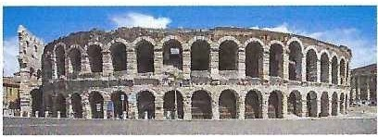

GATE
■^{Funded}Europeanthe ^{by} Union
l'IOGINllltJOUfQlf<sTm
The image of the gifted
children's teacher
The gifted classroom and a natural development arena
34
■^{Funded}Europeanthe ^{by} Union
The gifted classroom and a natural development arena
The classroom is a space for common development for all sides, both the students and the teacher.
It is a place where growth is shared and relies on interdependence.
A space where everyone - pupils and teachers -
learns and not just study material. They learn about themselves and about life as individuals, a team, a class, and a society.
35
-­
GATE
■Fundedby
theEuropeanUnion
IIOr.tAMHllOU'POllCM'no
NCITNOOEOSl'UOOffl
The gifted classroom and a natural development arena
A gifted class should be a space of openness and trust
- this is a challenge when it comes to gifted that are
always critical, doubtful, and sometimes suspicious.
Theclass should be an opportunity to experience trust in a protected environment.
For the teacher it is an "open classroom door" giving
the opportunity to beobserved, assessed, mentored
andgiven feedback.
36

Slide 117



■Fundedby
theEuropeanUnion
The gifted classroom and a natural
development arena
The gifted and the teachers are observing, watching, assessing and judgingeach one constantly, the classroom should become a secured place to understand it and to learn from it.
The classroom is a place where everyone might be wrong, the gifted and the teacher. Learning there is about what do wedo with the mistake or the failure and how do we extract learning.
■^{Funded}theEuropean^{by} Union
r,tl'Let
\;;,;IglJAINERIZE
37
38
--NCITN.Wl'lOSMltMTS
GATE
■^{Funded}Europeanthe ^{by} Union
l'IOQWM l'OSl..-ortClfTRI
39

Slide 119

Teaching Methods and Strategies
for Teachers of Gifted
Students
Dr. Ofer Keren, PhD.

Slide 120
A Quick Moment for Terminology
Definition of Method:
A procedure, systematic plan, technique or process of doing something.
Definition of Strategy:
Choosing an action or process for achieving a goal.

Slide 121
Why?
Why should we use different methods and
strategies when teaching gifted students?
3

Slide 122
Strategies build Environment
An educational environment is based on interactions, acceptance, time and space.
It allows to diverse, create, decide and change as we go along, both teachers and students.
More freedom for both teachers and students.
4

Slide 123
Uniqueness of the Gifted Child
Building a supportive environment that –
ccepts and cherishes diversity.
allows space and time for exploration, challenging norms and self expression.
personal difficulties ≠ interruptions.
5

Slide 124
Environments promote objectives
a supportive educational environment helps to–
Develop the potential.
Accept oneself and evolve
Build an autonomous identity.
6

Slide 125
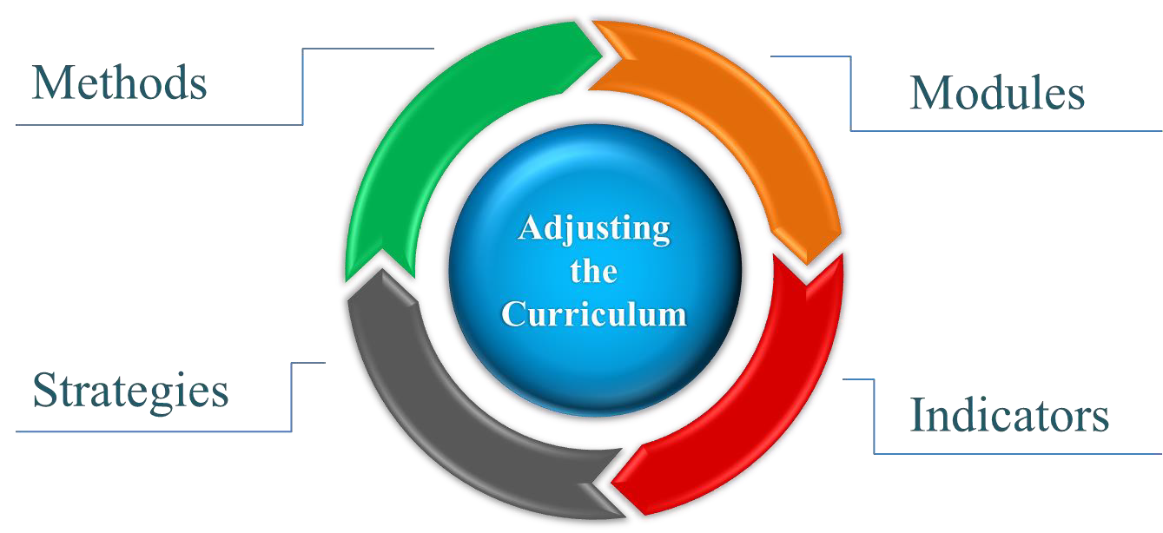
All along, we must remember
There is no gifted teaching without adjusting
the curriculum

Slide 126
Methods of Teaching—Learning
Teacher
Which kind of
method should I use?
Students
Study Material

Slide 127
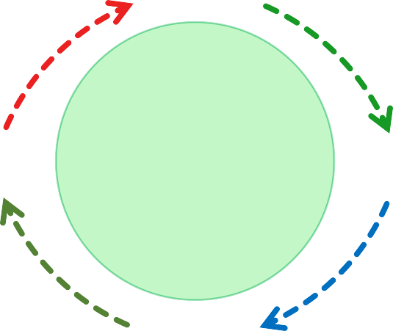

Teaching—Learning Methods
Teacher
Students
A vessel for passing forward
Knowledge.
With strategies: also, skills
and proficiencies
Receive, absorb. With strategies: communicate, interact, feedback, adjust himself, find his own character

Slide 128
Teaching—Learning Methods
Exposition | Inquiry | Demonstration | Activity mode
lecture Story Explanation A quote Movies | Asking Questions Hypothesis Analysis Self-Learning The key is inte | Experiments Role-playing games grating metho | Exhibitions Fairs Working in groups Peer-learning ds

Slide 129

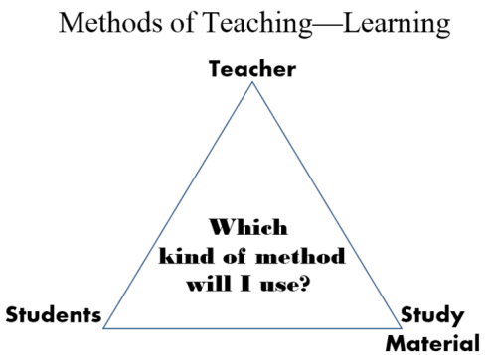
Strategies for Teaching—Learning
Teaching
methods
Time
Curricula
assessment
A broad system of process organization
Grouping
Learning assessment
Organizing
the classroom
Students
assessment

Slide 130
So many decisions…
Teaching
methods
Curricula
assessment
Which Strategy should I choose?
Time
A system of
organizing process
Grouping
Learning assessment
Organizing
the classroom
Students
assessment

Slide 131
We choose
the strategy that will serve our goal.
13

Slide 132
Educational Goals and Strategies
Accountability: field trip, inquiry, role play, public trial.
Gathering information: information and communication technologies, inquiry, event analysis.
Empathy: role playing, simulations.
Flexibility: brain storming, group discussion, aquarium.

Slide 133
Educational Goals and Strategies
Analytical thinking: event analysis, text and visual analysis.
Critical thinking: attitudes and positions exercise, public trial.
Self and peer learning: jigsaw, inquiry, raising questions.
Problem solving: group discussion, simulation, brainstorming.

Slide 134

my strategy
my goal

Slide 135
Accountable Discourse
for Teachers of Gifted Students
Dr. Ofer Keren Tali Lacks-Zur Shiri Lev-Ary

Slide 136
Accountable Discourse – Rational:
Allowing each student to participate in a fertile theoretical discourse.
A Community of Discourse respects democracy.
Peer meetings of different views and opinions.
Expressing one's voice with respect to the other.

Slide 137
Accountable Discourse - 3 rules:
Commitment to the community.
Commitment to standards thinking.
Commitment to knowledge.
137

Slide 138
Commitment to the community
Atmosphere, respectful discourse, room for various voices.
Listening, responding ➔ contributes to the discourse.
Asking, objecting, explaining ➔ contributes to the discourse.
138

Slide 139
Commitment to standards of thinking
Standards of thinking, unlike associations or intuitions, demand precision.
Ideas are fully and logically presented and explained.
Argumentative activity: the participants "speak" their thinking while self-controlled.

Slide 140
Commitment to standards of thinking
Standards of thinking, unlike associations or intuitions, demand precision.
Ideas are fully and logically presented and explained.
Argumentative activity: the participants "speak" their thinking while self-controlled.

Slide 141
Commitment to knowledge
Trusted sources, facts, laws, studies, expert— opinions, etc.
Provide evidence—based claims and explanations, counter arguments, and drowned conclusions accordingly.
7

Slide 142
The Ethical Code for Peer Assessment
We are establishing our process on transparency honesty and professional openness.
We investigate our profession in order to learn and develop and not to judge or criticize.
We assume it’s only a part of a wider connection.

Slide 143
GATE project 1st Learning, Teaching and Training Activity (LTTA)
October 17-21, 2022
Kaunas Lithuania
Seminar by
Dr. Yehuda Hamovitz

Slide 144
GATE dissemination workshop
Workshop’s program
Day 1 – The gifted arena.
Day 2 - The image of the gifted children's teacher.
Day 3 –Learning strategies and assembling a Leeson.
Day 4 - Participants give monitored and feedbacked lessons.
Day 5 - Teaching techniques and learning strategies.

Slide 145

Teaching techniques and learning strategies

Slide 146
Teaching techniques and learning strategies
The holistic-cognitive approach to teaching gifted children.
The social emotional approach to teaching gifted children.
The structure of a curriculum adequate for gifted children.
Building the skeleton for the curriculum.
Creating a full pedagogic approach and program.
Liberated teaching while being demanding.

Slide 147
Teaching techniques and learning strategies
Developing emotional resilience among gifted children.
Total failure- Intentional encounter with learning difficulties for building ability and resilience.
Historic role play – becoming a gifted teacher.
The dual glasses model for teaching in gifted classes.

Slide 148
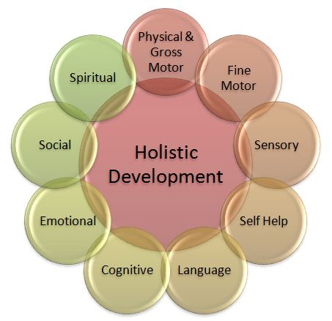
The holistic-cognitive approach to teaching gifted children
Physical & gross motor
Fine motor
Sensory
Self-help
Language
Cognitive
Emotional
Social
Spiritual

Slide 149
The holistic-cognitive approach to teaching gifted children
Physical & gross motor: structure, concept, theme
Fine motor: subjects, interests, sources
Sensory: touching, hugging, getting dirty, working physically
Self-help: self-learning, gaining information, resilience
Language: commonly used terms, wording, expressing
Cognitive: understanding situations and generalization
Emotional: developing resilience, patience
Social: ability to share, working in a team
Spiritual: developing concept of the world, values

Slide 150
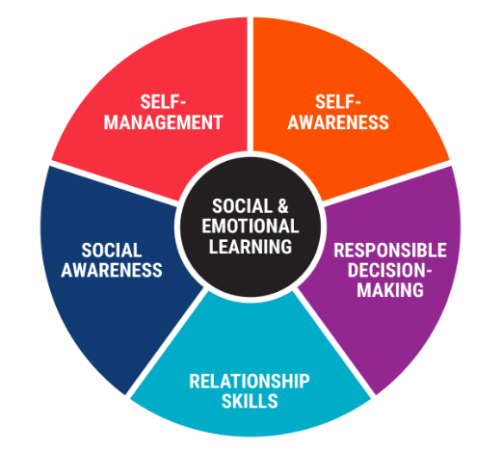
The social emotional approach to teaching gifted children
Self-awareness
Responsible decision making
Relationship skills
Social awareness
Self-management

Slide 151
The social emotional approach to teaching gifted children
Self-awareness:
How do I look? How do I behave? How am I perceived?
Responsible decision making:
Taking decisions that serves my interests.
Relationship skills:
Interacting with peers, with the surrounding (that might be inferior to me), with sources of authority.

Slide 152
The social emotional approach to teaching gifted children
Social awareness:
What is going on around me? What am I expected to do?
Self-management:
Coping with everyday duties and responsibilities.

Slide 153
The structure of a curriculum adequate for gifted children
The structure of a curriculum for gifted classes – 1:
The curriculum will be built with the involvement of the teachers in the gifted classrooms, as well as pedagogic instructors and other relevant figures.
Curriculum combining content and teaching styles in order to deliver enrichment, deepening and broadening.
Combining team learning with individual learning.
Creating challenging learning experience, that suits to the level of pupils and the scope of their knowledge and the relevancy for them. The curriculum should allow deepening, complexity bridging between different fields and aim for promoting creativity, curiosity and doubt.

Slide 154
The structure of a curriculum adequate for gifted children
The structure of a curriculum for gifted classes -2:
Creating the path for partnership and active involvement of the pupil – involving him with choosing the content of his studies and the way it will be delivered to him and making him a full partner in the pedagogic process.
Matching the studied content to the individual and to the class, in terms of acceleration, scope and the way they will be presented.
Including the parents as partners to the educational process within the gifted classes in terms of mutual decision making, supporting, updating and general involvement.
Including potential role models in the curriculum.

Slide 155
Building the skeleton for the curriculum
The skeleton will be constructed while integrating emotional and social process as well as relating to values and their importance, to answer the year to year continuity while integrating content from science, humanities and art.
The skeleton will be constructed as a perennial spiral, by the school educational staff with the pedagogic instructor. The program will relate to distribution of content and skills in every age area to allow maximum exposure to the gifted children.

Slide 156
Building the skeleton for the curriculum
The skeleton will be constructed according to the following parameters:
Desired content and skills matching the needs and interest of the gifted and the learning opportunities we want to offer.
In every age layer the gifted should be exposed to all the fields, science. Humanistic and art.
In of coordination between the gifted class in the regular school and the gifted school to which they go once a week.

Slide 157
Building the skeleton for the curriculum
Coordination between the age layers to create a educational perennial.
Coordination between the classes at school and external entities and programs like academic seminars, enriching programs etc.
Integrating the curriculum with multidisciplinary and intradisciplinary content to answer the gifted curiosity.
Skills of the 21st century beside rhetoric, logics and philosophy.

Slide 158
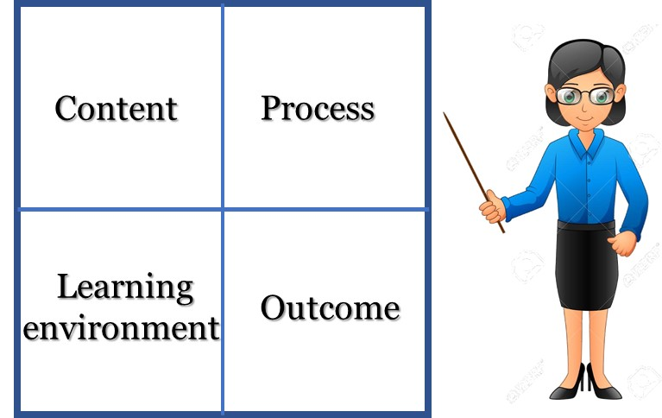
Creating a full pedagogic approach and program
Model for creating direct pedagogy for gifted
(Joan maker 1982 – renewed)

Slide 159
Creating a full pedagogic approach and program
Content:
Simplification
Complexity
Ex-curriculum
Life itself
Reorganize for learning
Values
Issues from the real world
Content chosen by pupil
Learning environment
Process:
Complex thinking
Experts’ research methods
Assembling research hypothesis
Learning through research
Open self-experiment
Flexible learning pace
Reflection and study
Pupil choose process
Variety and diversity

Slide 160
Creating a full pedagogic approach and program
Learning environment:
Excepting
Complex
Flexible
High mobility
Independence
Concentrating on the pupil
Openness
Teams in a flexible organization
Outcome:
Authentic audience
Evaluation, assessment and feedback
Pupil chooses outcome
Formation and transformation
Variety and diversity

Slide 161
Liberated teaching while being demanding
The rational:
There is no point for frontal teaching.
Emphasis on process and not on accumulating knowledge.
The teacher as a supervisor on learning processes.
Creating dynamic learning process that progress in light of the both the class and the teacher.

Slide 162
Liberated teaching while being demanding
Basic principles:
Liberated teaching - The teacher as a guide and not a leader.
Demanding teaching – high expectations and self-learning.
Creating class internal culture – the teacher is not the sole owner of knowledge. Class take responsibility for the learning.

Slide 163
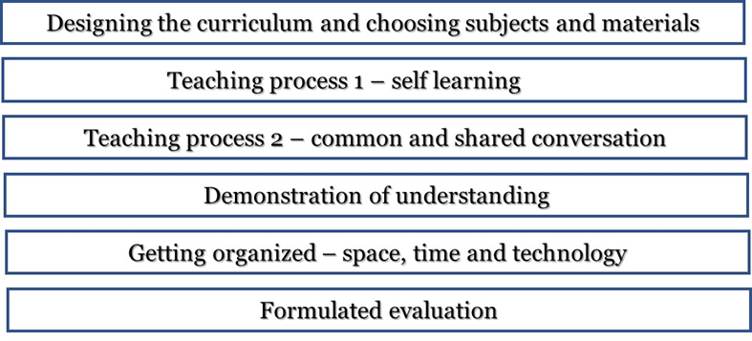
Liberated teaching while being demanding
Modus operandi:

Slide 164
Developing emotional resilience among gifted children.
One of the key ideas behind "Emotional response" is that part of role of the teacher is to help the gifted to develop emotional and mental resilience.
How to cope with this huge task? There is no recipe.
We can mark a series of messages of emotional resilience. In the specific context of the gifted, it’s worth thinking about how these messages can be corresponded with the class.

Slide 165
Developing emotional resilience among gifted children.
The messages are:
Multiple points of view: developing the sense that the pupil’s point of view is only one of many possible it is important to understand it in order of developing relations with others.
The understanding that every experience is temporary and changing: The understanding of the fluency of life, of past- present and future, accumulative knowledge and experience as a path for development.

Slide 166
Developing emotional resilience among gifted children.
The messages are:
Friendliness and Humor: moderating the seriousness often characterized the gifted, lighting up and joke on things as a mean of blending in external society.
See the positive: gifted as analytics tend to look for the negative, the deviant and the wrong. This tendency should be balanced with opposite experiences.

Slide 167
Developing emotional resilience among gifted children.
The messages are:
The power of togetherness and belonging: the individual cannot satisfy his needs solely. We need the other, to relate to him. The gifted need to explore a common language with the surrounding to experience belonging.

Slide 168
Developing emotional resilience among gifted children.
The messages are:
The power of influencing: gifted has the ability and the tendency to capture the “big picture” and sometimes feel inferior, powerless and despair via those “big pictures”. The story of David vs. Goliath is a key subject where the inferior with his wisdom defeat the evil.

Slide 169
Developing emotional resilience among gifted children.
The messages are:
Multiple ways to exist in the world: Gifted tend to see themselves as irregular and strange to the society. They tend to become introvert. They need guidance to go out to the world and be part of it using their strengths to become equal and influencing member of their community.

Slide 170
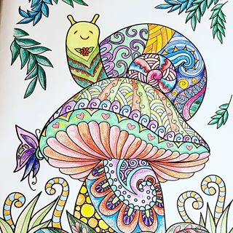
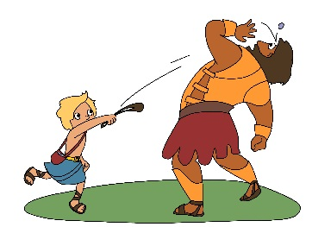
Developing emotional resilience among gifted children.

Slide 171
Total failure- Intentional encounter with learning difficulties for building ability and resilience
Rational:
Gifted develop at the age of elementary school a justified self-perception of having higher learning abilities. This perception is based on the scope of successes and the feedback from their surroundings.
Secondary school is the first place when they actually can experience difficulties and even failures coping with the academic learning.

Slide 172
Total failure- Intentional encounter with learning difficulties for building ability and resilience
Rational:
This experience meets them without the necessary resilience and might lead to discouraging and even avoiding behaviors.
Those failures might become designing experience to mature behavior, resilience and strength.

Slide 173
Total failure- Intentional encounter with learning difficulties for building ability and resilience
Goals of the teaching practices:
Developing capabilities and resilience allowing coping with difficulties and failures.
Developing the capabilities of working in uncertain conditions.
Developing meta-cognitive skills.
Building a class environment in which difficulties and failure are not connected to “not being smart enough”.

Slide 174
Total failure- Intentional encounter with learning difficulties for building ability and resilience
Basic principles of the teaching practices:
Confronting the difficulties and the failures.
Working in uncertain conditions.
Class climate nurturing learning.
Working on reflection and meta-cognitive skills.

Slide 175
Total failure- Intentional encounter with learning difficulties for building ability and resilience
Confronting the difficulties and the failures.
Delivering very difficult assignments.
Condense or partial teaching.
Emphasize mistakes – but not the mistaken person.
Specification of the difficulty.

Slide 176
Total failure- Intentional encounter with learning difficulties for building ability and resilience
Working in uncertain conditions.
Leaving questions open and unsolved.
Teacher avoids relating to answers and solutions.
Practicing a technique to achieve solution without understanding it (like in mathematics).
Modeling of solving exercises by the teacher.

Slide 177
Total failure- Intentional encounter with learning difficulties for building ability and resilience
Class climate nurturing learning.
Giving legitimacy to not understanding or difficulties.
Criticizing patronizing, snobbish and arrogant behaviors.
Learning from mistakes.
Developing asking skills rather answering ones.

Slide 178
Total failure- Intentional encounter with learning difficulties for building ability and resilience
Working on reflection and meta-cognitive skills.
Delivering self-study assignments and later reflect on the process rather than on the outcomes.
Sharing pedagogic considerations as for assignments given.
Mutual learning before an examination.

Slide 179
Historic role play – becoming a gifted teacher
Goals of the teaching practice:
Significant and challenging learning
A response to the multiple-intelligences and the scope of roles in the class.
An opportunity to inter-related work among the gifted – nurturing social aspects.
Responding to the gifted need for autonomy.

Slide 180
Historic role play – becoming a gifted teacher
Basic principle of the teaching practice:
Pupils work in teams, conduct research and create knowledge around the chosen subject.
Having a significant assignment – thought and arranged.
The assignment demands complicated processing of data and knowledge.

Slide 181
Historic role play – becoming a gifted teacher
Preparation needed:
Selecting the subject that will be the base for the assignment.
Defining the purpose and the goals of the assignment.
Dividing the assignment to sub-assignments to be delivered to the different groups.
Dividing the pupils to the groups, after close consideration and delivering the considered matched sub-assignments.

Slide 182
Historic role play – becoming a gifted teacher
Modus operandi:
Prolog and introduction.
Dividing class to teams.
Team research and understanding the sub-assignments.
Teams get organized –dividing responsibilities.
Assignment launched.
Work process – teams work to deliver.
The final product combined.
Understanding and analysis of results and process.
General evaluation on delivery – process and results.

Slide 183
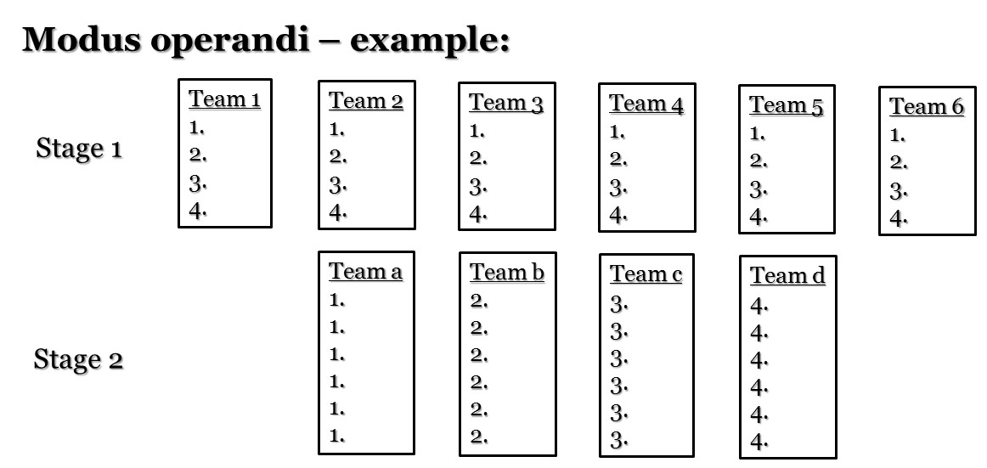
Historic role play – becoming a gifted teacher

Slide 184
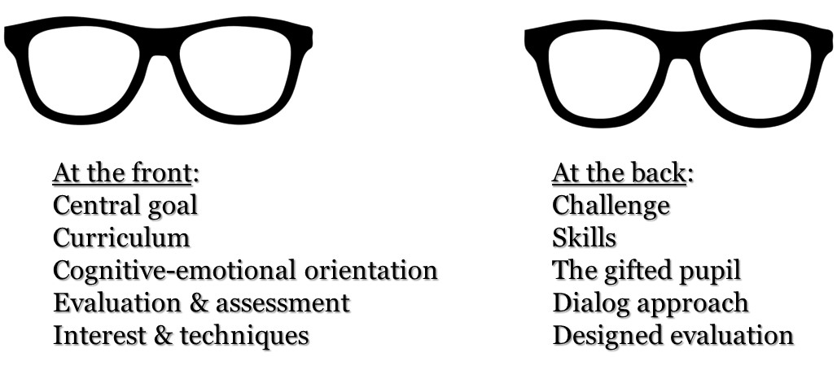
The dual glasses model for teaching in gifted classes.

Slide 185
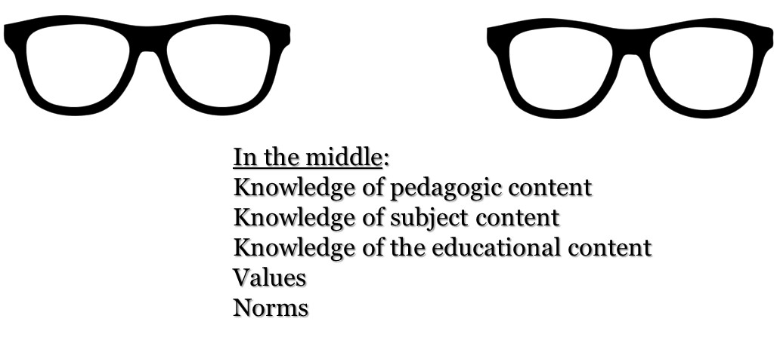
The dual glasses model for teaching in gifted classes.

Slide 187
-NC1T"LlNTionu0om:­
GATE
■^{Funded}Europeanlhe ^{by} Union
TOQ.IM)lfl".#WI
GATE projeet 1st Learning, Teaehing
and Training Activity (LTIA)
October 17-21, 2022
Kaunas Lithuania
Seminar by
Dr. Yehuda Hamovitz
1
-­
GATE
■Fundedby
lheEuropeanUnion
t()su,,otf{ollffl)
OOTN.OO!l)S!\IIIIITT
GATE dissemination workshop
Workshop's program
Day 1 - The gifted arena.
Day 2 -The image of the gifted children's teacher.
Day 3 -Learning strategies and assemblinga Leeson.
Day 4 - Participants give monitored and feedbacked lessons.
Day 5 - Teaching techniques and learning strategies.
2
GATE
Tl"(KISTIAN«,
l'tOCW!Ml!TOSlffl:lttrll'lO
ANOMl.(lfflOST\IOENlS
■^{Funded}Europeanthe ^{by} Union
Teaching techniques and learning strategies lJJJJll J
Day
5
3

Slide 188
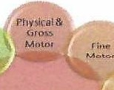

t'M GATE
■Funded by
:_";"'.....,"'111) theEuropeanUnion
-Teaching techniques
and learning strategies
The holistic-cognitive approach to teaching gifted children. The social emotional approach to teaching gifted children. The structure of a curriculum adequate for gifted children. Buildingthe skeleton for the curriculum.
Creating a full pedagogic approach and program. Liberated teaching while being demanding.
4
GATE
--
■Funded by
theEuropeanUnion
NCITAl.tlml>ST\116m
Teaching techniques and learning strategies
Developing emotional resilience amonggifted children. Total failure- Intentional encounter with learning difficulties for buildingability and resilience.
Historic role play- becoming a gifted teacher.
The dual glasses model for teaching in gifted classes.
5
?M GATE
■Fundedby
theEuropeanUnion
5:" orno
The holistic-cognitive approach to teaching gifted children
Physical & gross motor Fine motor
Sensory
Self-help
Language Cognitive Emotional Social Spiritual
Splrit1.,1nf
Holistic
Development
SP11S01y
(motional
'SrlfHetp
6

Slide 189
AlGATE
■Fundedby
theEuropeanUnion
='"'.:"""
The holistic-cognitive approach to teaching gifted children Physical & gross motor: structure, concept, theme
Fine motor: subjects, interests, sources
Sensory: touching, hugging, getting dirty, working physically Self-help: self-learning,gaining information, resilience
Language: commonly used tenns, wording, expressing Cognitive: understaudingsituations and generalization Emotional: developing resilience, patience
Social: abilityto share, working in a team Spiritual: developing concept of the world, values
7
GATE
■Fundedby
theEuropeanUnion
=.":"'.....,.,,..
AN'TM.UfflOm.a:NTS
The social emotional approach to teaching gifted children
••
Self-awareness
Responsible decision making Relationship skills
Social awareness Self-management
•
8
-­
GATE
■^{Funded}Europeanthe ^{by} Union
l'IIOr.aNff'IOU'POlfQflfD
#f>TIII.Offl()fM)Ol'I$
The social emotional approach to teaching gifted children
Self-awareness:
How do I look? Howdo I behave? How am I perceived?
Responsible decision making:
Taking decisions that serves my interests.
Relationship skills:
Interacting with peers, with the surrounding (that might
beinferior to me), with sources of authority.
9

Slide 190


■^{Funded}Europeanlhe ^{by} Union
The social emotional approach to teaching gifted children
Social awareness:
What is going on around me? What am I expected to do?
Self-management:
Coping with everyday duties and responsibilities.
10
■^{Funded}Europeanthe ^{by} Union
The structure of a curriculum adequate for gifted children
The structure of a curriculum for gifted classes - 1: The curriculum will be built with the involvement of the teachers in the giftedclassrooms, as well as pedagogic instructors and other relevant figures.
Curriculum combiningcontent and teachingstyles in orderto
deliver enrichment, deepening and broadening. Combining team learning with individual learning.
Creatingchallenging learningexpetience, thatsuitsto the level of pupils and the scopeof theirknowledge and the relevancy for
them.The curriculum shouldallow deepening, complexity bridgingbetween different fields and aim forpromoting creativity, curiosityand doubt.
11
GATE
■Fundedby
theEuropean Union
;:.n;,-,_."""'
w,uu,moma,m
Thestructure of a curriculum adequate for gifted children
The structure of a curriculum for gifted classes -2: Creatingthe path for partnership and active involvement of the pupil - involving him with choosingthe content of his studiesand the way il wUJ be delivered to him and makinghim a f1.1ll partner in the pedagogicprocess.
Matching the studiedcontent to the individual and to the class, in terms of acceleration,scopeand the waythey will be presented. Including the parentsas partnersto the educational process within the gifted classesin terms of mutual decision making, supporting, updatingand general involvement.
Including potential role models in the curriculum.
12

Slide 191
GATE
■Fundedby
theEuropean Union
SUPTOff{ifflD
""B"""u"i"l"d""in""g the skeleton for the curriculum
The skeleton will be constructed while integrating emotional and social process as well as relating to values and their importance, to answer the year to year continuity while integrating content from science, humanities and art.
The skeleton will be com,1ruL1ed as a perennial spiral,
by the school educationaI staff with the pedagogic instructor. The program will relate to distribution of content and skills in every age area to allow maximum exposure to the gifted children.
13
GATE
=.. llMOl'GFTfO
flNDfllWffll>ST\IWm
■Fundedby
theEuropean Union
Building the skeleton for the curriculum
The skeleton will be constructed according to the following parameters:
Desired content and skills matching the needs and interest of the gifted and the learning opportunities we
want to offer.
In every age layer the giftedshould be exposed to all
the fields, science. Humanistic and art.
In of coordination between the gifted class in the
regular school and the gifted school to which they go once a week.
14
GATE
=.., _,.,om,
■^{Funded}Europeanthe ^{by} Union
IINl>fllU.lfTIDm.atffl
Building the skeleton for the curriculum
Coordination between the age layers to create a educational perennial.
Coordination between the classes at school and
external entities and programs like academic seminars,
enriching programs etc.
Integrating the curriculum with multidisciplinary and intradisciplinary content to answer the gifted curiosity. Skills of the 21st century beside rhetoric, logics and
philosophy.
15

Slide 192


■Fundedby lheEuropean Union Creatinga full pedagogic approach and program Model for creating dircc,-t pedagogy for gifted (Joan maker 1982 - renewed)
 | Content | Process
 | Learning environmen | Outcome
16
GATE
...S.l..W...O..f.f.(.",,,ffll)
■^{Funded}Europeanthe ^{by} Union
Creatinga full pedagogic approach and program
Content: Simplification Complexity Ex-curriculum Life itself
Reorganize for learning Values
Issues from the real world Content chosen by pupil Learning environment
Process:
Complex thinking
Experts' research methods Assembling research hypothesis
Learning through research Open self-experiment Flexible learning pace
Reflection and study Pupil choose process Variety and diversity
17
!5
Fundedby
---
theEuropeanUnion
flCI.INMTOUPOITCl1iD
Creating a full pedagogic approach and program
Learningenvironment:
Excepting Complex Flexible
High mobility Independence
Concentrating on the pupil Openness
Teams in aflexible
organization
Outcome:
Authentic audience
Evaluation, assessment and feedback
Pupil chooses outcome
Formation and transformation Variety and diversity
18

Slide 193


GATE
=:,_-;-...,..,<fltl>
■^{Funded}Europeanthe ^{by} Union
Nf01N.U"1DftWCHTS
Liberated teaching while being demanding
The rational:
There is no point for frontal teaching.
Emphasis on process and not on accumulating knowledge.
The teacher as a supervisor on learning processes. Creating dynamic learning process that progress in light of the both the class and the teacher.
19
:=,.'-;-_"""' ■^{Funded}European^{by}the Union
GATE
MIDT"W(ltOS'!\lDUffl
Liberated teaching while being demanding
Basic principles:
Liberated teaching -The teacher as a guide and not a
leader.
Demanding teaching - high expectations and self­
learning.
Creating class internal culture - the teacher is not the sole owner of knowledge. Class take responsibilityfor
the learning.
20
■^{Funded}Europeanthe ^{by} Union
Liberated teaching while being demanding
Modus operandi:
Designing the curriculum and choos.ingsubjects and materials Teaching process 1 - self learning
Teaching process 2 - corn1no11a.nd shared conversation
Demonstration of unclerstm1djng
Getting org1tnized - space, time und technology
Formulated evaluation
21

Slide 194
GATE
■^{Funded}Europeanthe ^{by} Union
= Sl,ffO«t(,ffll)
AA10TN.ooto ffi.Q;IITT
Developing emotional resilience among gifted children.
One of the key ideas behind "Emotional response" is that part of role of the teacher is to help the gifted to develop emotional and mental resilience.
How to cope with this huge task? There is no recipe.
We can mark a series of messages of emotional resilience. In the specific context of the gifted, it's worth thinking about how these messages can be corresponded with the class.
22
GATE
■Fundedby
theEuropeanUnion
SIJll'OIH'll(D
jl,Nl)lllUHTfOmatffl
Developing emotional resilience among gifted children.
The messages are:
Multiple points of view: developing the sense that the pupil's point of view is only one of many possible it is important to understand it in order of developing relations with others.
The understanding that every experience is
temporary and changing: The understanding of the fluency of life, of past- present and future,
accumulative knowledge and experience as a path for development.
23
GATE
■Fundedby
theEuropeanUnion
�
l;lfT(o
Developing emotional resilience among gifted children.
The messages are:
Friendliness and Humor: moderating the seriousness often characterized the gifted, lighting up and joke on things as a mean of blending in external society. See the positive: gifted as analytics tend to look for the negative, the deviant and the wrong. This tendency should be balanced with opposite experiences.
24

Slide 195



■Fundedby
theEuropean Union
Developing emotional resilience among gifted children.
The messages are:
The power of togetherness and belonging: the individual cannot satisfy his needs solely. We need the other, to relate to him. The gifted need to explore a common language with the surrounding to experience belonging.
25
■^{Funded}oruEthe ^{by}ep anUnion
Developing emotional resilience amonggifted children.
The messages are:
The power of influencing: gifted has the abilityand
the tendency to capture the "big picture" and sometimes feel inferior, powerless and despair via those "big pictures". The story of David vs. Goliath is a key subject where the inferior with his wisdom defeat the evil.
26
■Fundedby
theEuropeanUnion
Developing emotional resilience among gifted children.
The messages are:
Multiple ways to exist in the world: Gifted tend to see themselves as irregular and strange to the society.
They tend to become introvert. They need guidance to
go out to the world and be part of it usingtheir strengths to become equal and influencing member of their community.
27

Slide 196
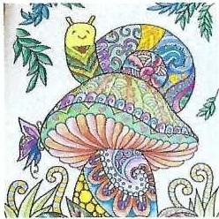
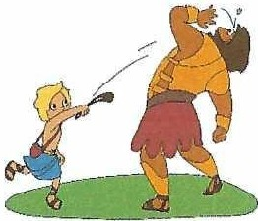


GATE
■Fundedby
theEuropean Union
fOll.llfOtlca,ffl)
Developing emotional resilience among gifted children.
28
■^{Funded}Europeanthe ^{by} Union
Total failure- Intentional encounter withlearning
difficulties for building ability and resilience
Rational:
Gifted develop at the ageof elementary school a
justifiedself-perception of having higher learning abilities. This perception is based on the scope of successes and the feedback from their surroundings. Secondary school is the first place when they actually can experience difficulties and even failures coping with the academic learning.
■Fundedby
theEuropean Union
Total failure- Intentional encounter with learning difficulties for building ability and resilience
Rational:
This experience meets them without the necessary resilience and might lead to discomaging and even
avoiding behaviors.
Those failures might become designing experience to mature behavior, resilience and strength.
29
30

Slide 197

GATE
!:.cn:- ,""₀
Fundedby
fliNDTAWITTOffl.OOm
theEuropean Union
Total failure- Intentional encounter with learning
difficulties for buildingabilityand resilience
Goals of the teachingpra<-'l:ices:
Developing capabilities and resilience allowing coping with difficulties and failures.
Developing the capabilities of working in uncertain
conditions.
Developing meta-cognitive skills.
Building a class environment in which difficulties and failure are not connected to "not being smart enough".
31
the^{Funded}European^{by} Union
Total failure- Intentional encounter with learning
difficulties for building ability and resilience
Basic principles of the teaching practices: Confronting the difficulties and the failures. Working in uncertain conditions.
Class climate nurturing learning.
Working on reflection and meta-cognitive skills.
32
GATE
Funded by
""""n­
theEuropeanUnion
NDGMNHl10S1...orJarm,
NCIT#tDITB>ffllOOOS
Total failure- Intentional encounter with learning difficulties for building abilityand resilience
Confronting the difficulties and the failures.
Delivedng very cUfficult assignments.
Condense or partial teaching.
Emphasize mistakes - but not the mistaken person. Specification of the difficulty.
33

Slide 198

^{F}the^{und}European^{edby} Union
Total failure- Intentional encounter with learning
difficulties for building ability and resilience
Working in uncertain conditions.
Leaving questions open and unsolved.
Teacher avoids relating to answers and solutions. Practicing a technique to achieve solution without
understanding it (like in mathematics). Modeling of solving exercises by the teacher.
34
-Nt01-.omt-­)ffl,ID(tm
GATE
Fundedby
flOC'.INoNl05IM'Ollam>
theEuropeanUnion
Total failure- lntentional encounter with learning difficulties for building ability and resilience
Class climate nurturing learning.
Givinglegitimacy to not understanding or difficulties. Criticizing patronizing, snobbish and arrogant
behaviors.
Learning from mistakes.
Developing asking skills rather answering ones.
35
GATE
=:.,....,..,..
■^{Funded}Europeanthe ^{by} Union
AIC>WOfTUlm.K191TJ
Total failure- Intentional encounter with learning difficulties for building ability and resilience
Working on reflection and meta-cognitiveskills. Delivering self-study assignments and later reflect on the process rather than on the outcomes.
Sharing pedagogic considerations as for assignments given.
Mutual learning before an examination.
36

Slide 199


■Fundedby
theEuropeanUnion
Historicrole play - becoming a gifted teacher
Goals of the teaching practice:
1. Significant and challenging learning
2. A response to the multiple-intelligences and the scope of roles in the class.
An opportunity to inter-related work among the gifted
- nurtw.ing social aspects.
Responding to the gifted need for autonomy.
■Fundedby
theEuropeanUnion
Historic role play - becoming a gifted teacher
37
Basic principle of the teaching practice:
1. Pupils work in teams, conduct research and create knowledge around the chosen subject.
2. Having a significant assignment - thought and
arranged.
3. The assignment demands complicated processing
of data and knowledge.
38
-­
GATE
■Fundedby
theEuropeanUnion
flOGtNMTOsu,,orfGW'l(I)
H"i"s''"t"o'"r"i"c"r""o'le play - becoming a gifted teacher
Preparation needed:
1. Selecting the subject that will be the base for the
n.ssign1nent.
2. Defining the purpose and the goals of the assignment.
Dividing the assignment to sub-assignments to be delivered to the different groups.
Dividing the pupils to the groups, after close consideration and delivering the considered matched sub-assignments.
39

Slide 200
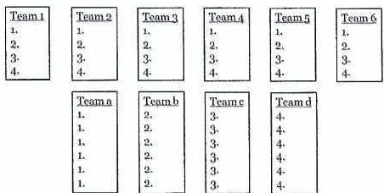
G_,_ATE
■^{Funded}Europeanthe ^{by} Union
rwc;IIWM'!O c;lfllV
Nl11NftfllOnwtmS
Historic role play - becoming a gifted teacher
Modus operandi:
1. Prolog and introduction.
2. Dividing class to teams.
Team research and understanding the sub-assignments.
Teams get organized -dividing responsibilities.
Assignment launched.
Work process - teams work to deliver.
The final product combined.
Understanding and analysis of results and process.
General evaluation on delivery - process and results.
40
GATE
=.":"..'...,..,..
■^{Funded}Europeanthe ^{by} Union
NGTIIWffl.DSl\.l)(H'IS
Historic role play- becoming a gifted teacher
Modus operandi - example:
Stase 1
Stage2
41
GATE
=':"'......,..,..
■^{Funded}Europeanthe ^{by} Union
The d^{-"}u"a""l"g"l"a""s"ses model for teaching in gifted classes.
CJCJ
CJCJ
At the front:
Central goal Curriculum
Cognitive-emotional orientation
Evaluation & assessment
Interest & techniques
At the back: Challenge Skills
The gifted pupil Dialog apprnach
Designed evalu tion
42

Slide 201


GATE
:,. ,_,.....
■^{Funded}Europeanthe ^{by} Union
#il>IN,arnOJ.I\IUHtS
The dual glasses model for teaching in gifted classes.
O\J O\J
In the middle:
Knowledge of pedagogic content Knowledge of subject content Knowledge of the educational content Values
Norms
43
■^{Funded}Europeanthe ^{by} Union
Let
\;,;;I glJNNERIZE
44
-­
---
GATE
■^{Funded}Europeanthe ^{by} Union
l'll0f,MIM,O CErUI
Thank you, all of you From all ofus.
45

Slide 202

Thank you, all of you
From all of us.

